Slide 1
Rotational inertia estimation: Swing test results

Slide 2
4 methods for inertia estimation:
CAD: SolidWorks model with all components with matched masses. No modelled wires.
Manual calculation: Measure damped period of oscillation and decay rate along with linear model of a pendulum to calculate inertia.
Linear state-space (LSS) model estimation: Use MATLAB's System Identification Toolbox to match a linear pendulum model to the captured data by varying inertia and some other parameters.
Non-linear state-space (NLSS) model estimation: Similar to above but instead using a non-linear model.

Slide 3
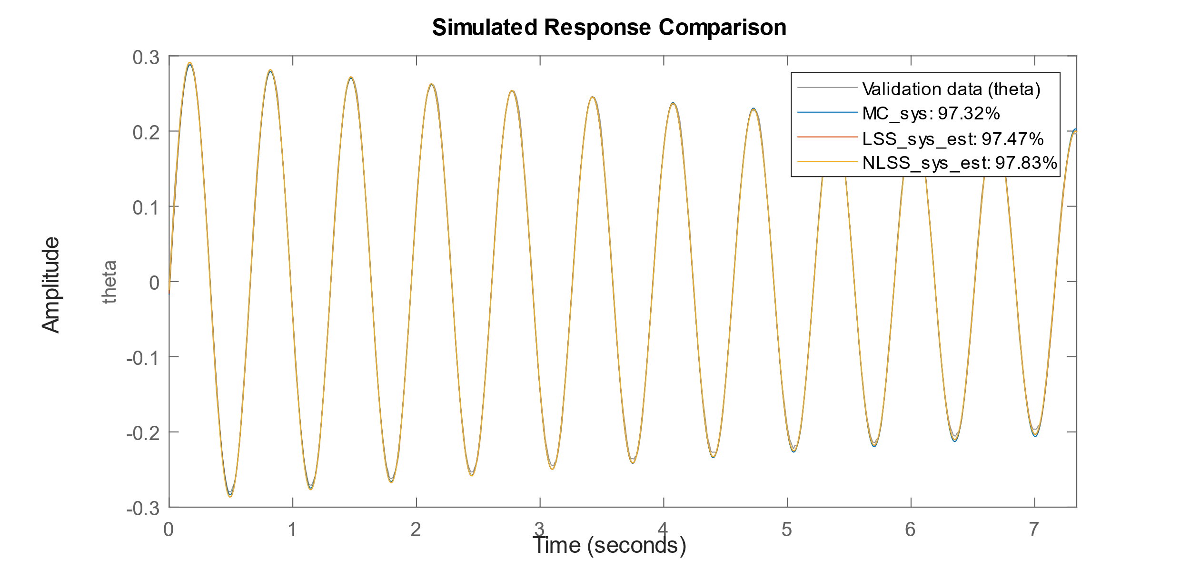
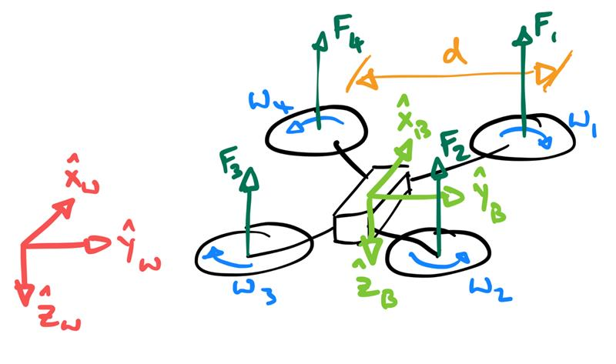



X axis inertia
 | I (g.mm^2) | % from CAD | Model fit | Damping coefficient | theta0 | dtheta0
CAD | 1.4724e+06 | N.A. | N.A. | N.A. | N.A. | N.A.
Manual | 1.5966e+06 | +8.4345 | 97.322 | 0.00051232 | -0.0055 | 3.004
LSS | 1.5984e+06 | +8.5598 | 97.466 | 0.00055129 | -0.016168 | 2.8361
NLSS | 1.5586e+06 | +5.8599 | 97.826 | 0.00054695 | -0.01157 | 2.839

Slide 4
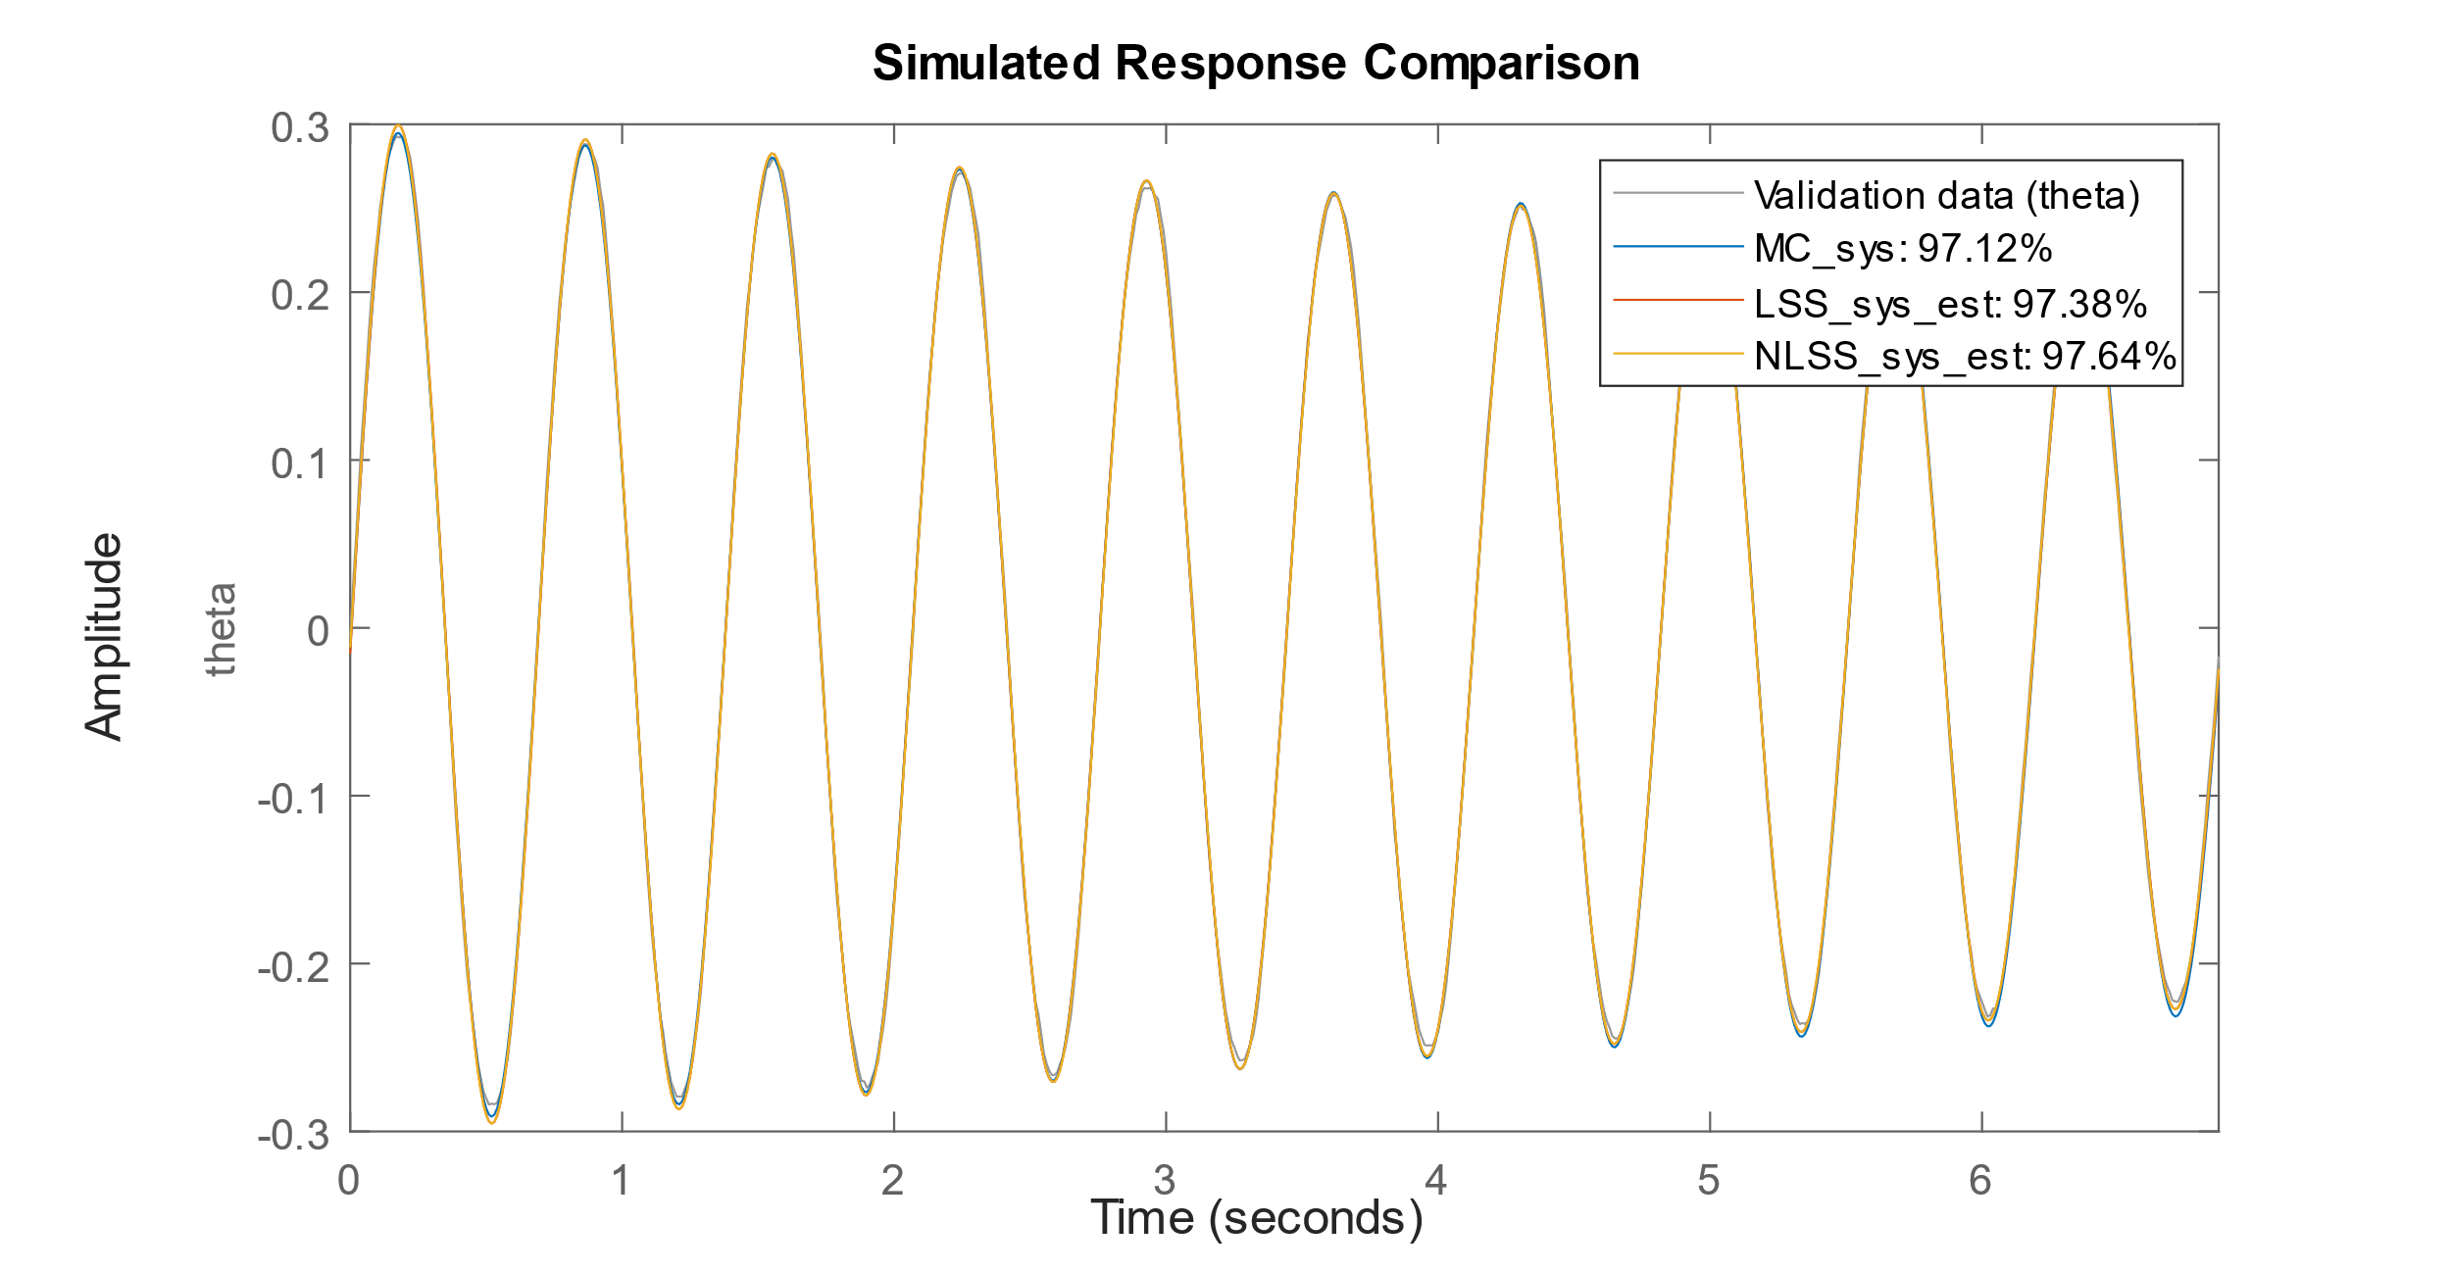
Y axis inertia
 | I (g.mm^2) | % from CAD | Model fit | Damping coefficient | theta0 | dtheta0
CAD | 2.0445e+06 | N.A. | N.A. | N.A. | N.A. | N.A.
Manual | 2.3037e+06 | +12.68 | 97.124 | 0.00039412 | -0.0053 | 2.94
LSS | 2.3003e+06 | +12.514 | 97.385 | 0.00045054 | -0.015382 | 2.7554
NLSS | 2.2542e+06 | +10.257 | 97.636 | 0.00044536 | -0.011706 | 2.758

Slide 5
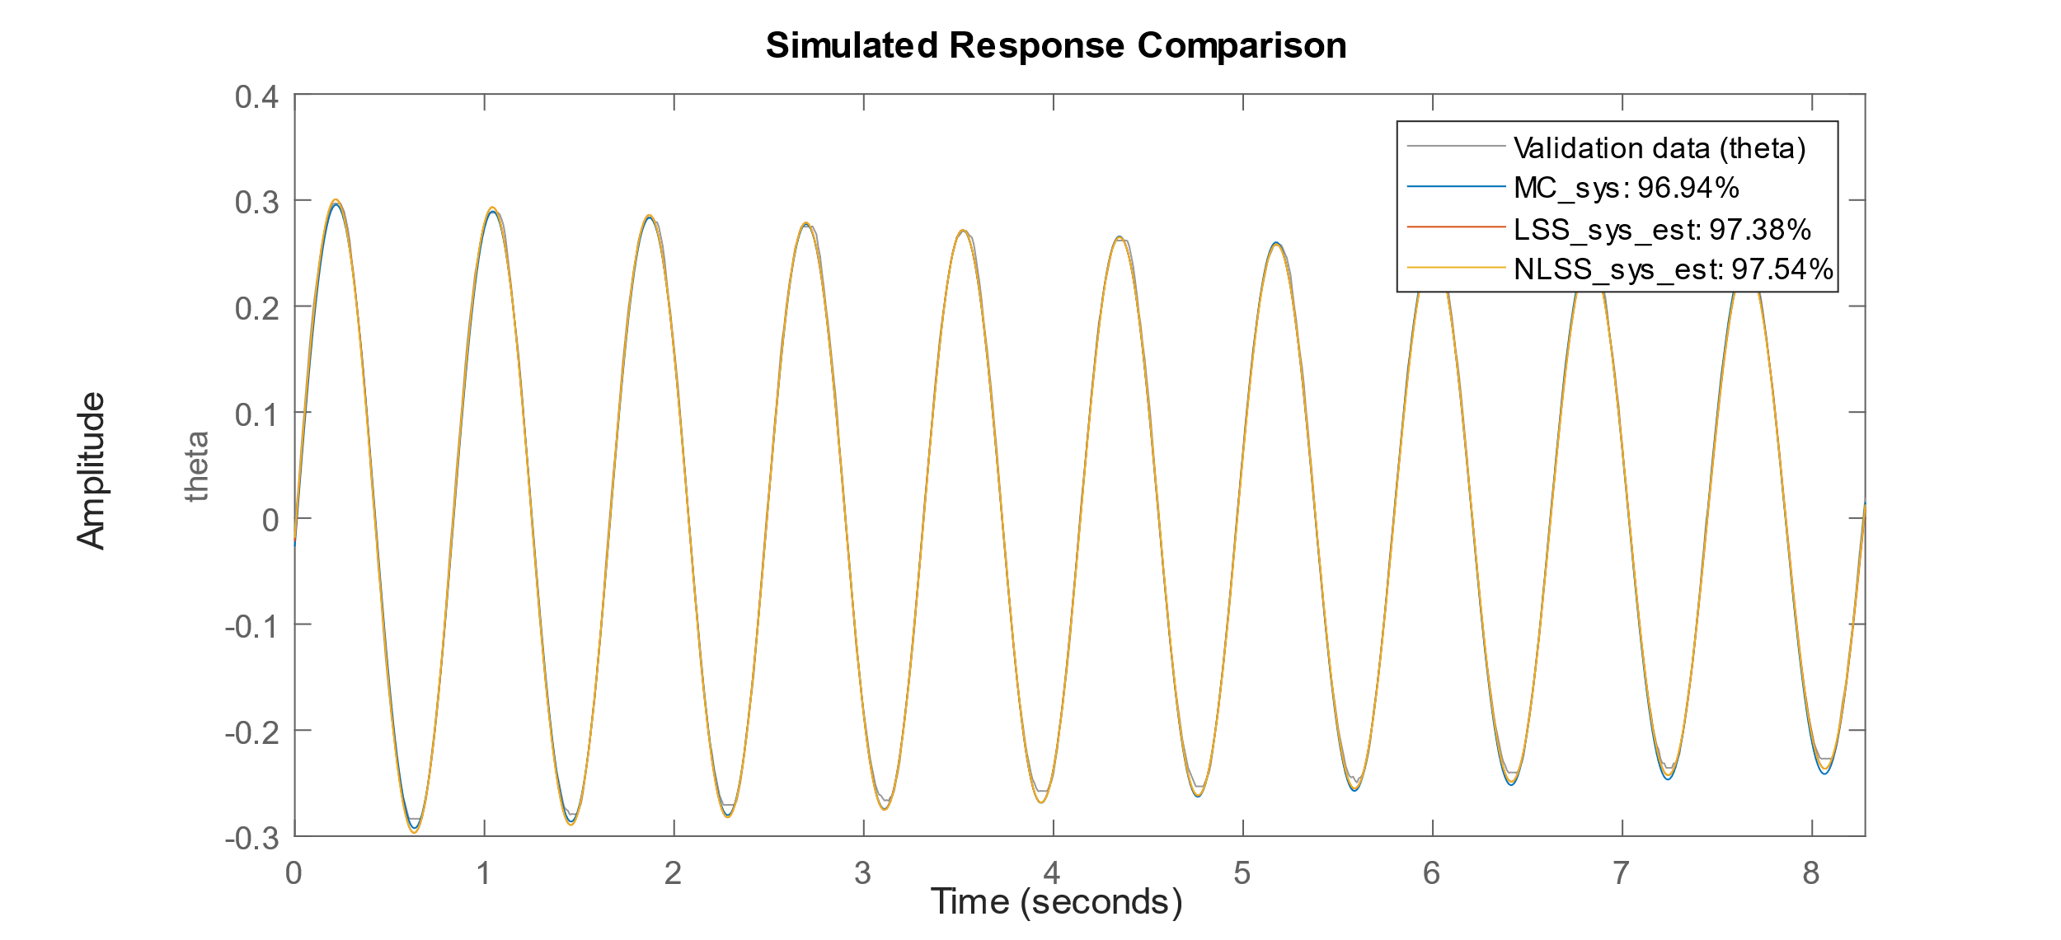
Z axis inertia
 | I (g.mm^2) | % from CAD | Model fit | Damping coefficient | theta0 | dtheta0
CAD | 2.9651e+06 | N.A. | N.A. | N.A. | N.A. | N.A.
Manual | 3.2972e+06 | +11.201 | 96.939 | 0.00079112 | -0.0113 | 4.17
LSS | 3.3155e+06 | +11.817 | 97.377 | 0.00094075 | -0.021986 | 2.297
NLSS | 3.1773e+06 | +7.1552 | 97.536 | 0.00092774 | -0.018609 | 2.2992

